Slide 1
Perceptual Linear Prediction (PLP) in Speech Processing

Slide 2
PLP
Perceptual Linear Prediction (PLP) is a speech feature-extraction technique used to represent speech in a compact form that is closely related to human auditory perception.
It is widely used in Automatic Speech Recognition (ASR), speaker recognition, speech classification, and speech analysis.
PLP combines:
Short-time Fourier analysis – finds the frequency content of speech.
Human auditory perception – models how the ear perceives different frequencies and loudness levels.
Linear Prediction (LP) – models the vocal-tract characteristics.
Cepstral representation – converts the spectral information into a small number of useful coefficients.

Slide 3
1. Pre-emphasis
The speech signal is first passed through a pre-emphasis filter: y[n]=x[n]-αx[n-1]
Where α ≈ 0.95-0.97
This emphasizes higher frequencies and compensates for the natural decrease in high-frequency energy in speech.

Slide 4
2. Framing and Windowing
Speech is non-stationary, but over a short period of about 20–30 ms, it can be considered approximately stationary.
The signal is therefore divided into overlapping frames.
For example:
Sampling frequency = 16 kHz
Frame duration = 25 ms
Frame length: 16000×0.025=400 samples
A window such as the Hamming window is then applied: x_{w}​[n]=x[n]w[n]

Slide 5
3. Fourier Transform
The FFT is applied to each frame: X(k)=FFT{x_{w}​[n]}
The power spectrum is obtained as: P(k)=∣X(k)∣²

Slide 6
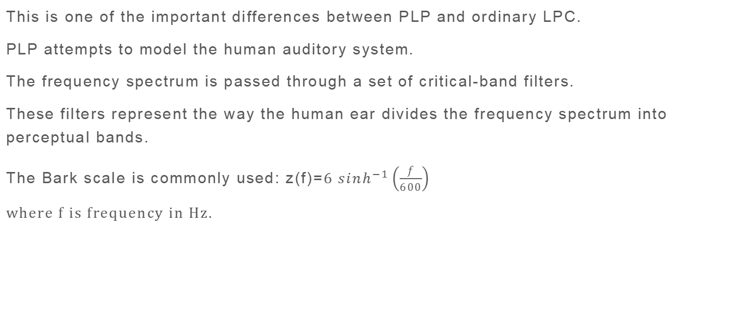
4. Critical-Band Analysis
This is one of the important differences between PLP and ordinary LPC.
PLP attempts to model the human auditory system.
The frequency spectrum is passed through a set of critical-band filters.
These filters represent the way the human ear divides the frequency spectrum into perceptual bands.
The Bark scale is commonly used: z(f)=$6 \sinh^{−1}\left(\frac{f}{600}\right)$
where f is frequency in Hz.

Slide 7
5. Equal-Loudness Pre-emphasis
The human ear does not perceive all frequencies with equal sensitivity.
For example, the ear is generally more sensitive to frequencies around the speech-sensitive mid-frequency region than to very low or very high frequencies.
PLP therefore applies an equal-loudness curve to the critical-band spectrum.
Conceptually: E(f)=P(f)×W(f)
where:
P(f) = critical-band power
W(f) = equal-loudness weighting
E(f) = perceptually weighted spectrum
This makes the representation more consistent with human auditory perception.

Slide 8
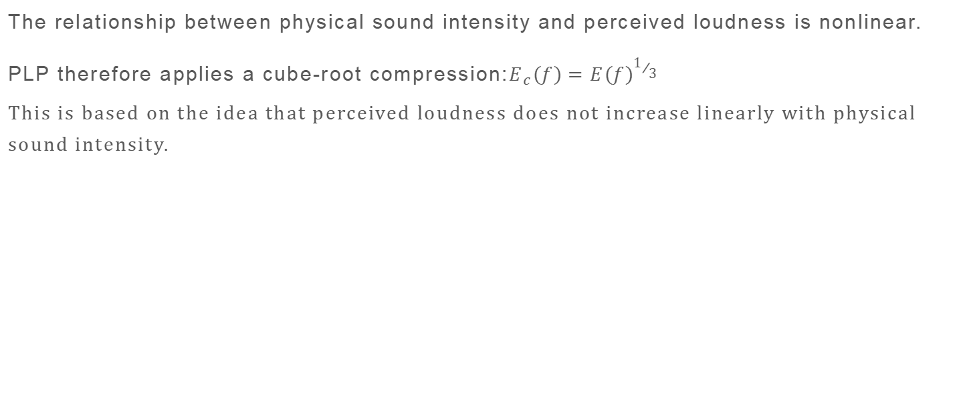
6. Intensity-Loudness Compression
The relationship between physical sound intensity and perceived loudness is nonlinear.
PLP therefore applies a cube-root compression:$E_{c}\left(f\right)=E{\left(f\right)}^{1/3}$
This is based on the idea that perceived loudness does not increase linearly with physical sound intensity.

Slide 9
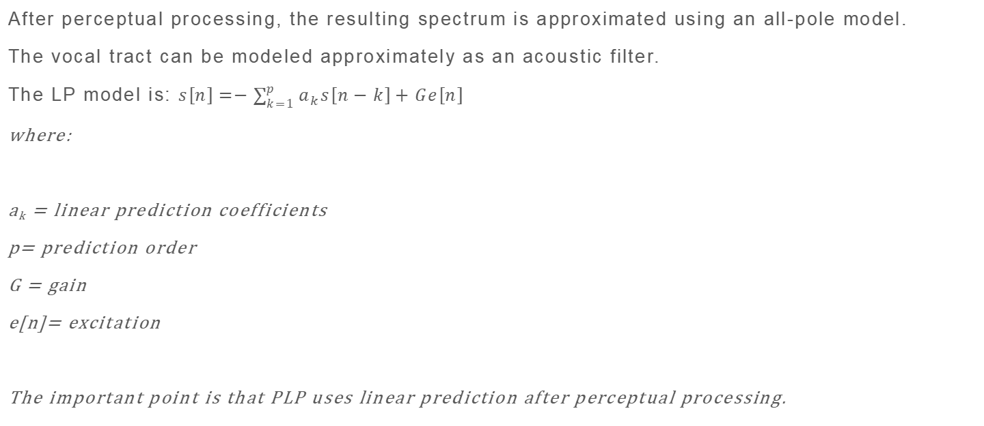
7. Autoregressive / Linear Prediction Modeling
After perceptual processing, the resulting spectrum is approximated using an all-pole model.
The vocal tract can be modeled approximately as an acoustic filter.
The LP model is: $s\left[n\right]=−\sum_{k=1}^{p}{a_{k}s\left[n−k\right]+Ge\left[n\right]}$
where:
a_{k} = linear prediction coefficients
p= prediction order
G = gain
e[n]= excitation
The important point is that PLP uses linear prediction after perceptual processing.

Slide 10
8. Conversion to PLP Cepstral Coefficients
The autoregressive model is converted into cepstral coefficients.
These coefficients are called PLP coefficients.
Typically, a small number such as 12–13 coefficients is retained.
For speech recognition, derivatives are often added:
PLP feature vector=[PLP,ΔPLP,Δ²PLP]

Slide 11
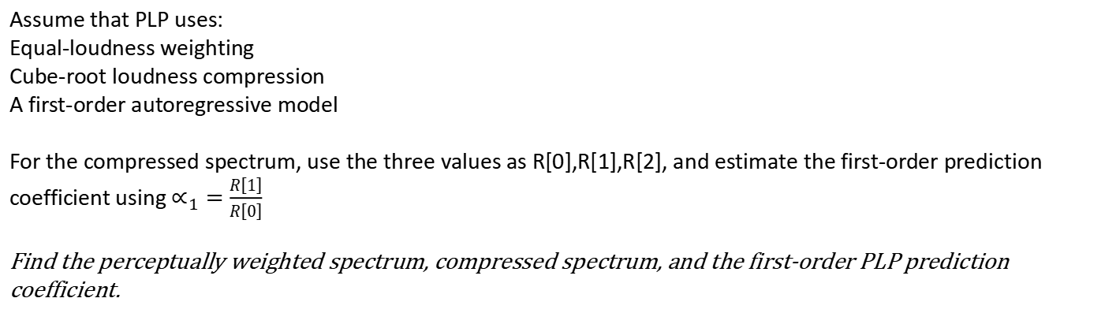
Example
Critical band | Frequency | Power P_{i} | Equal-loudness weight W_{i}
1 | 500 Hz | 100 | 0.8
2 | 1500 Hz | 400 | 1
3 | 2500 Hz | 900 | 0.7
Assume that PLP uses:
Equal-loudness weighting
Cube-root loudness compression
A first-order autoregressive model
For the compressed spectrum, use the three values as R[0],R[1],R[2], and estimate the first-order prediction coefficient using $∝_{1}=\frac{R\left[1\right]}{R\left[0\right]}$
Find the perceptually weighted spectrum, compressed spectrum, and the first-order PLP prediction coefficient.

Slide 12
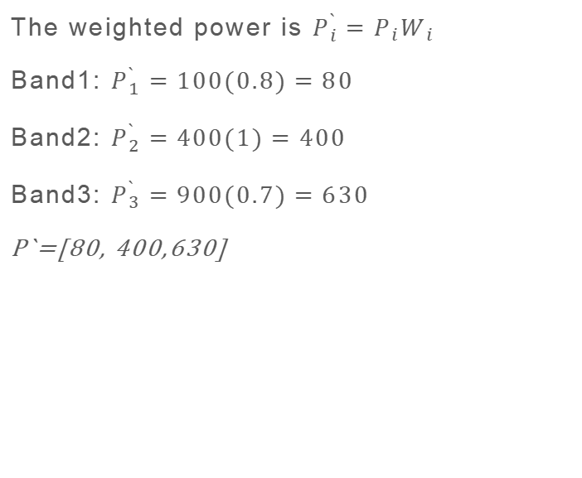
Step 1: Critical-band powers
Step 2: Equal-loudness weighting
The given powers are
P=[100,400,900]
These represent the energy in the three auditory critical bands.
The weighted power is $P_{i}^{`}=P_{i}W_{i}$
Band1: $P_{1}^{`}=100(0.8)=80$
Band2: $P_{2}^{`}=400(1)=400$
Band3: $P_{3}^{`}=900(0.7)=630$
P`=[80, 400,630]

Slide 13
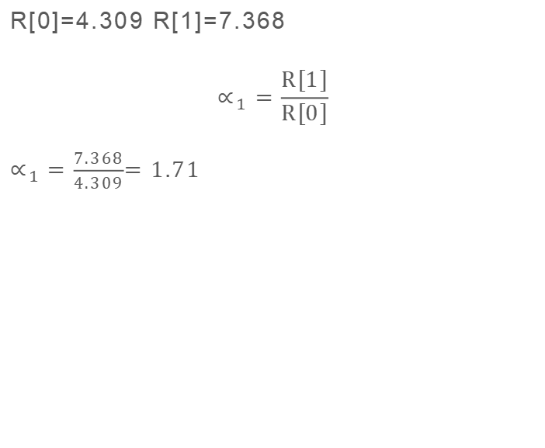
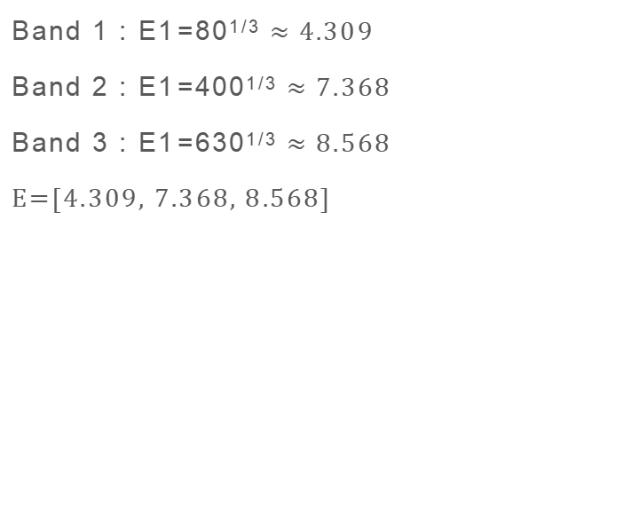
Step 3: Cube-root compression
Step 4: Linear prediction
Band 1 : E1​=80^{1/3} $≈4.309$
Band 2 : E1​=400^{1/3} $≈7.368$
Band 3 : E1​=630^{1/3} $≈8.568$
E=[$4.309$, $7.368$, $8.568$]
R[0]=4.309 R[1]=7.368
$$∝_{1}=\frac{R\left[1\right]}{R\left[0\right]}$$
$∝_{1}=\frac{7.368}{4.309}$= 1.71

Slide 14
Note
In a full PLP implementation, we do not normally calculate a₁ simply as R[1]/R[0] from three arbitrary band energies.
The actual procedure involves obtaining an auditory spectrum, converting it to an autocorrelation sequence (often through an inverse transform), and then solving the LPC equations, commonly using the Levinson–Durbin algorithm.
General Process:
Power spectrum → Bark critical bands → equal-loudness weighting → cube-root → autocorrelation → Levinson-Durbin → PLP coefficients.

